Slide 1
Deep Learning and Neural Networks
-An introduction to Neural Network Fundamentals
-Dikscha Sapraz

Slide 2
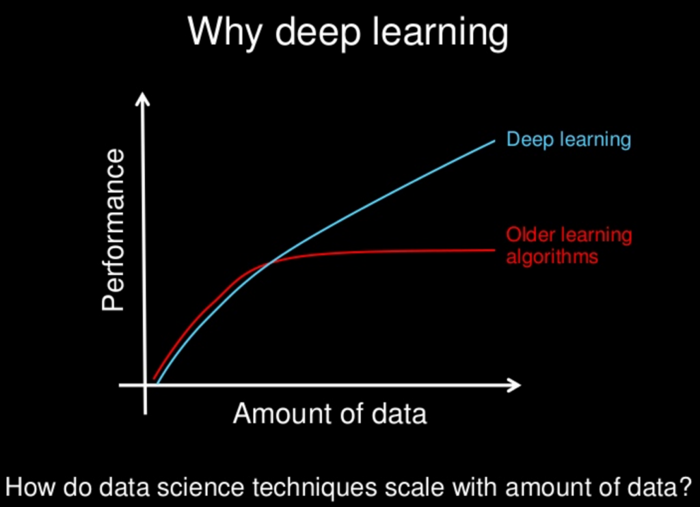
Why Deep Learning?
With increase in data, there is increase in the performance of the algorithm.
The same is not true for other Machine learning algorithms, as they reach a plateau after a certain amount of data is provided
Deep Learning is not a new technique, it has been around for decades, but it has only gained popularity in the last 15 years
Reason Being- Enormous increase in availability of data.
All images are taken from various internet resources, the author claims no ownership

Slide 3
Neural Networks
Neurons
Perceptron
is to
is to
Nervous System
Neural Network
All images are taken from various internet resources, the author claims no ownership

Slide 4
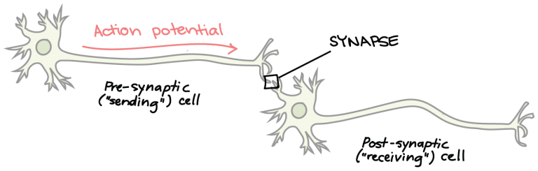
Brain Neurons
In brain neurons, signal is transmitted from one neuron to another till it reaches the nerve endings.
SYNAPSE: The transfer of electric signal between two neurons
All images are taken from various internet resources, the author claims no ownership

Slide 5
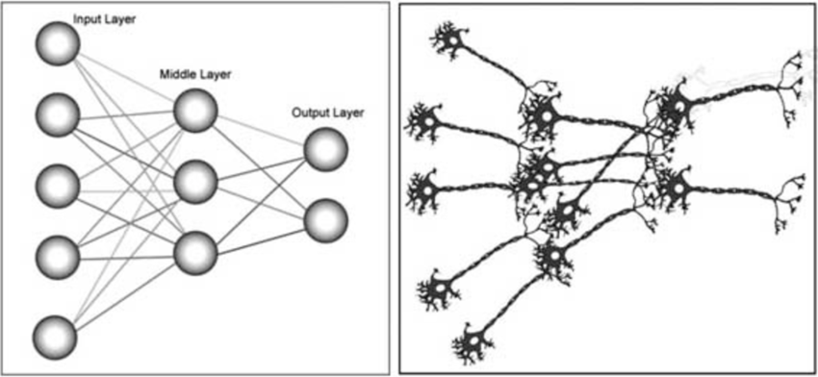
Neural Networks
As the name suggests, Neural networks (also called as Artificial Neural Networks ANN) are inspired by the neurons in the human brain.
Brain
Nervous System
Neural
Networks
All images are taken from various internet resources, the author claims no ownership

Slide 6
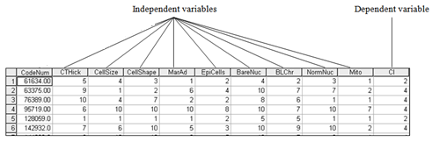
Perceptron- Single Layer Perceptron
Before we begin talking about Perceptron, let us look at a general dataset
Y
x₁ x₂ x₃ x₄ x₅ x₆ x₇ x₈ x₉ x₁₀
X
All images are taken from various internet resources, the author claims no ownership

Slide 7
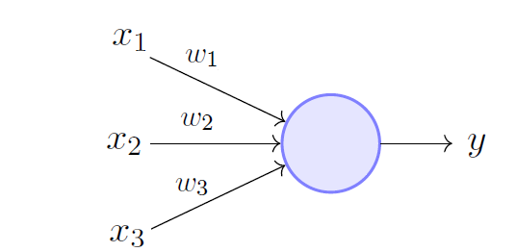
Perceptron-Single Layer Perceptron
Like a single unit in Neural Network is called Neuron, the single most basic unit in Artificial neural network is called Perceptron.
The various features of our dataset (independent values) are given as input x_{1,} x₂, x₃,.... x_{n}.
Each input feature is given a weight to determine how important it is.
Perceptron makes a decision y (dependent variable) on the basis of an activation function.
All images are taken from various internet resources, the author claims no ownership

Slide 8
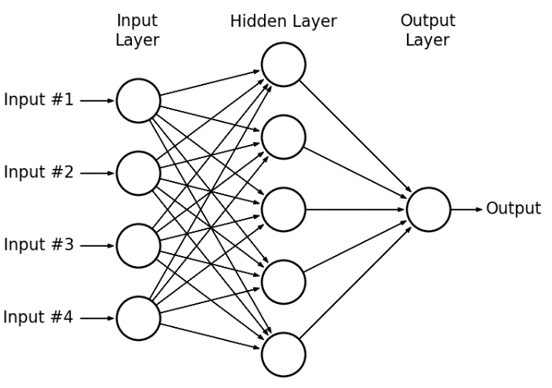
Multi Layer Perceptron
When a perceptron that teams up with additional perceptrons, stacked in several layers, to solve complex problems.
In this example, we have three layers-
Input layer
Hidden Layer
Output Layer
All images are taken from various internet resources, the author claims no ownership

Slide 9
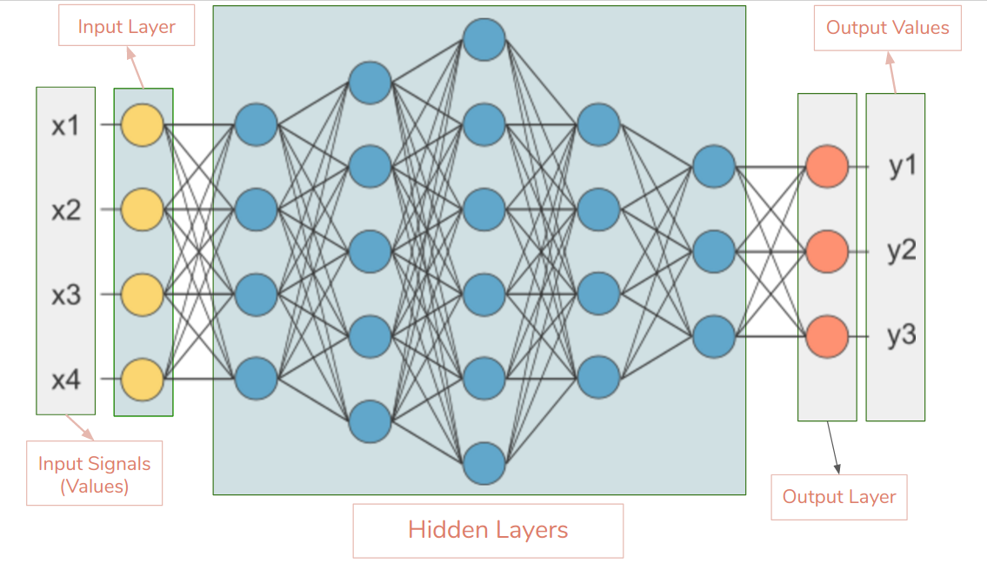
What are Hidden Layers?
Hidden layers constitute of all the layers in a Neural Network other than the input and the output layer - Hence the word hidden.
Hidden layers act like a black box - the internal mechanism is hidden.
Each layer contributes to the final output layer by applying some mathematical transformations
All images are taken from various internet resources, the author claims no ownership

Slide 10
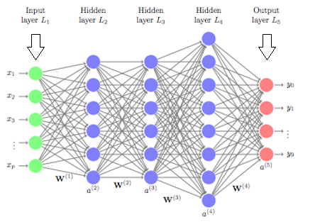
When is a Neural Network Called Deep?
Whenever there are more than 3 layers (Input, Hidden, Output) in a Neural Network, we call it a deep Neural network.
Each hidden layer has a certain meaning for the final classification.
Each layer helps in classifying, a certain aspect of the final output layer
All images are taken from various internet resources, the author claims no ownership

Slide 11
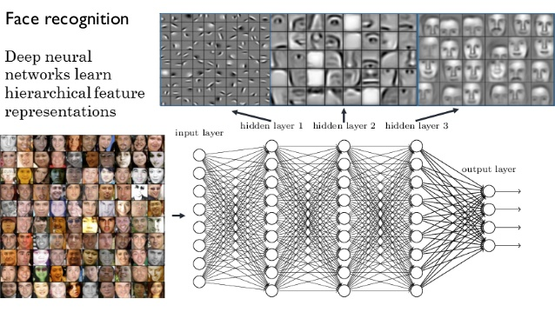
What do hidden layers do?
Let us consider a facial recognition Neural Network
The initial layers start small - They identify edges
The middle layer start to identify objects - like eyes, nose, ears etc.
The final layers start to identify the final images and hence recognise the entire face.
All images are taken from various internet resources, the author claims no ownership

Slide 12
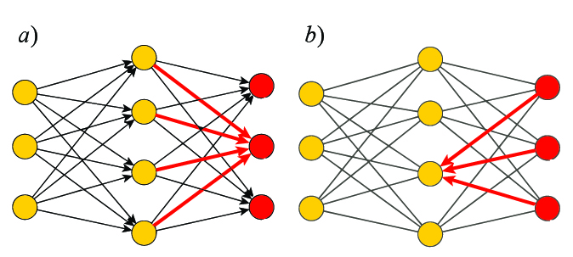
Forward and Backward Propagation
Forward Propagation
Backward Propagation
Forward Propagation: Signal goes from input layers towards output layers
Backward Propagation: Signal goes from output to input layers
Input layer Hidden Layer(s) Output Layer

Slide 13
Classification with Neural Networks
Classification: Predicting what class/group certain element belongs to.
Classify whether a person will repay loan or not
Classify whether a person has a disease or not
Classify emails as spam or not
Apply face recognition to identify people
And many many many more...
All images are taken from various internet resources, the author claims no ownership

Slide 14
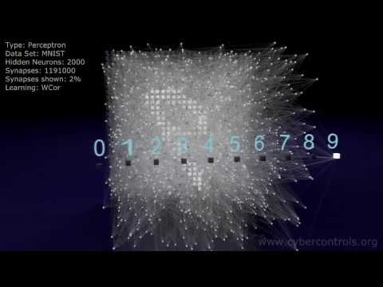
Neural Network Working: Handwriting recognition

Slide 15



Frameworks for DL in Python
Google’s DL framework.
Can also work on ioS and Android
Architectural limitation: TensorFlow’s architecture TPU only allows the execution of a model not to train it.
Operates with a dynamically updated graph. It allows you to make changes to the architecture in the process.
Not as easy for Deployment
It is built on top of TensorFlow. Designed to create neural networks with a complex architecture by DeepMind.
Mostly used to reproduce the research demonstrated in DeepMind’s papers with greater ease than Keras, since DeepMind will be using Sonnet themselves.

Slide 16
Let’s start working on deep learning techniques!
Downloadable links to the slides can be found here: https://docs.google.com/presentation/d/1efnSyGxKXV8-eGXngk2MmN_QhBD0I5OnbtCSMHao08k/edit?usp=sharing

